Slide 1
KESHAV MEMORIAL INSTITUTE OF TECHNOLOGY
DEPARTMENT OF CSE
Machine Learning
UNIT 2
(PART 3)
III CSE A
By
SRIKANTH G
(Asst Prof)

Slide 2
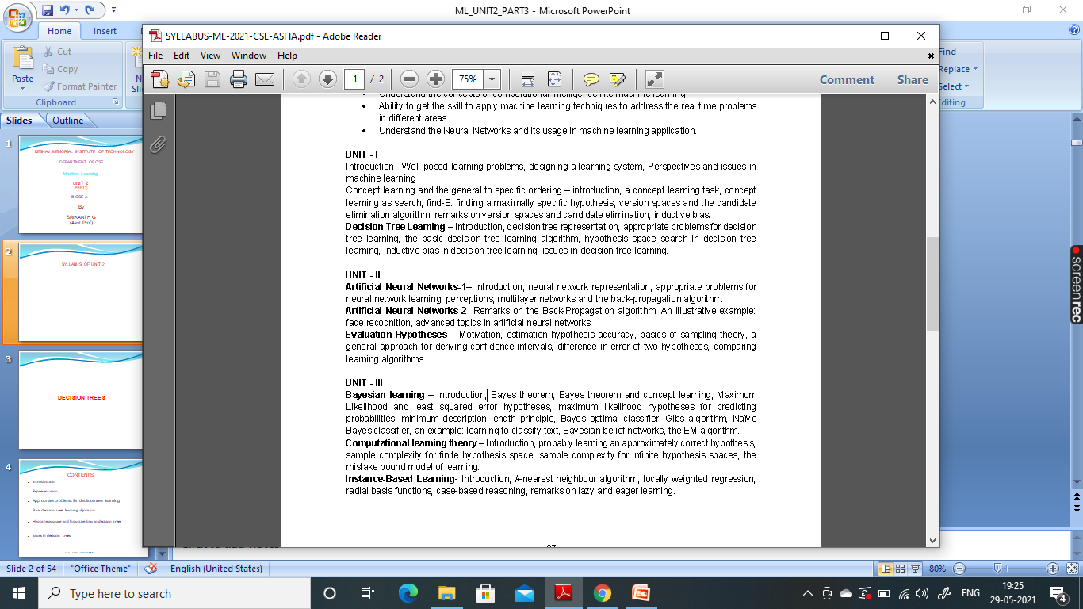
SYLLABUS OF UNIT 2

Slide 3
EVALUATION HYPOTHESES

Slide 4
CONTENTS
Motivation
Estimating Hypothesis Accuracy
Basics of Sampling Theory
A General Approach for Deriving Confidence Intervals
Difference in Error of Two Hypotheses
Comparing Learning Algorithms
CSE - KMIT- AUTONOMOUS

Slide 5
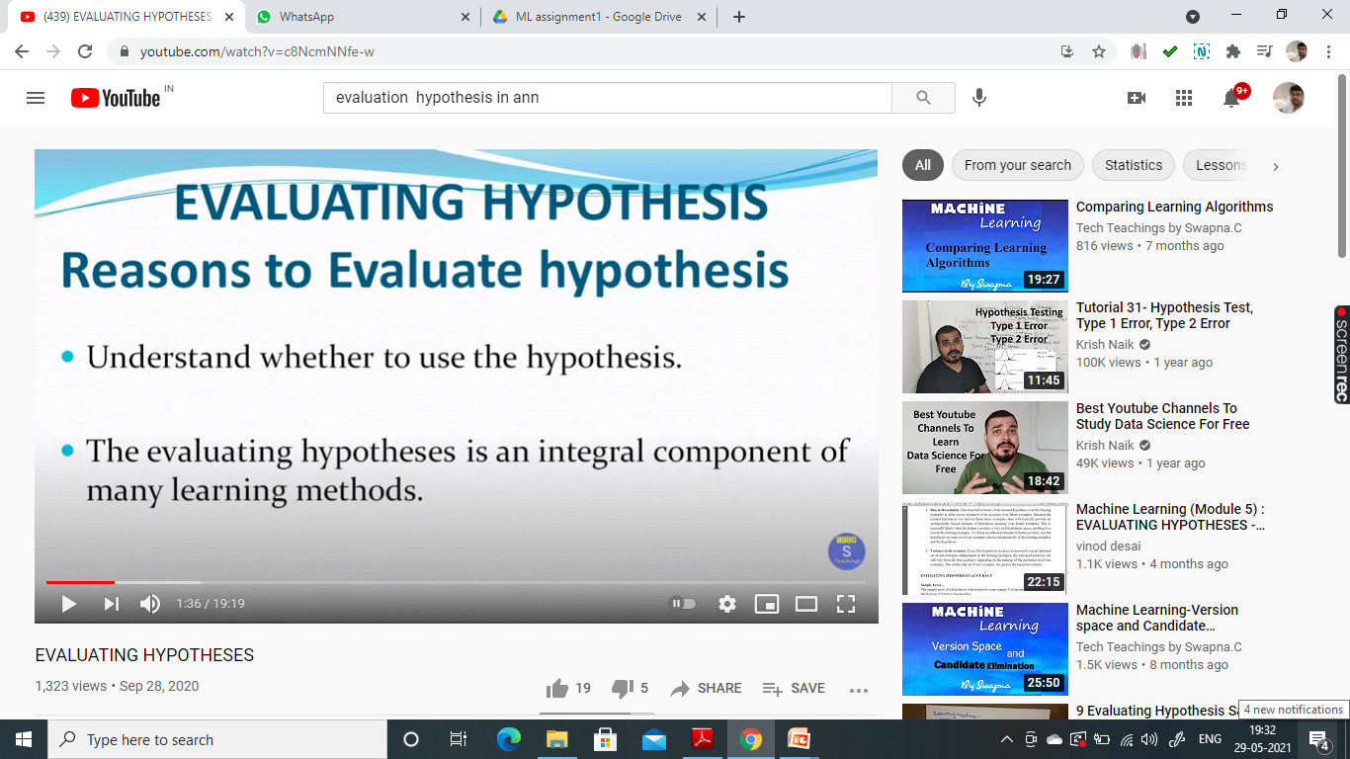

Slide 6
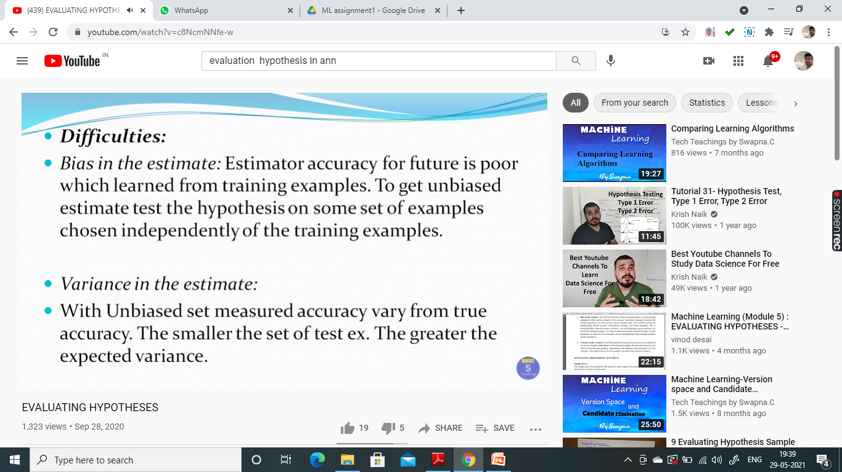

Slide 7
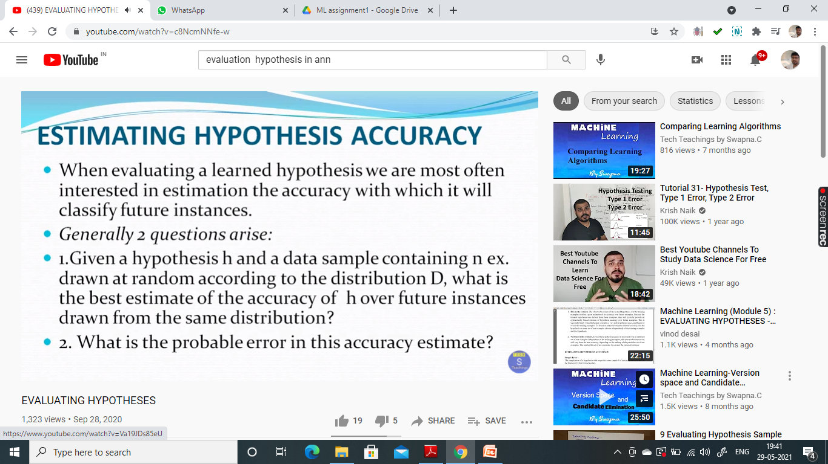

Slide 8
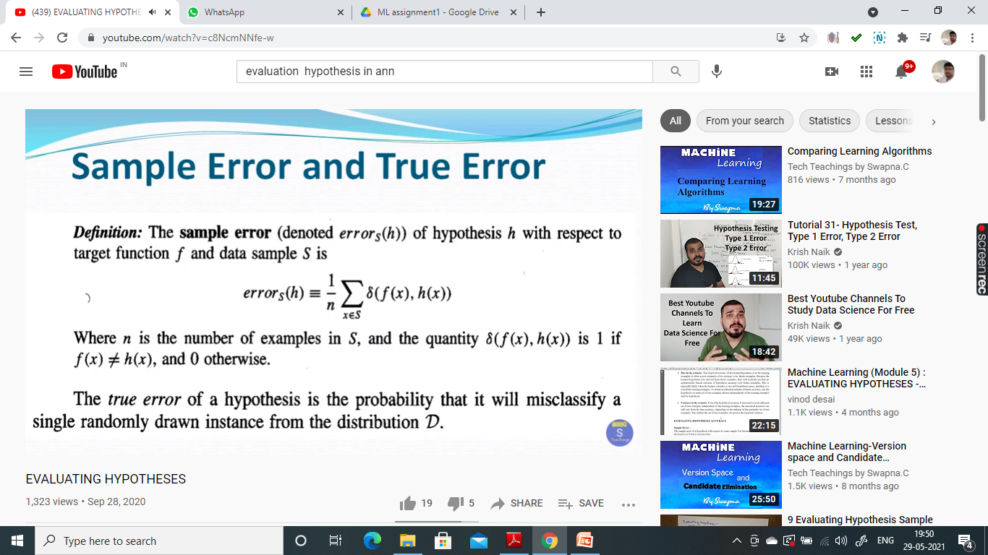

Slide 9
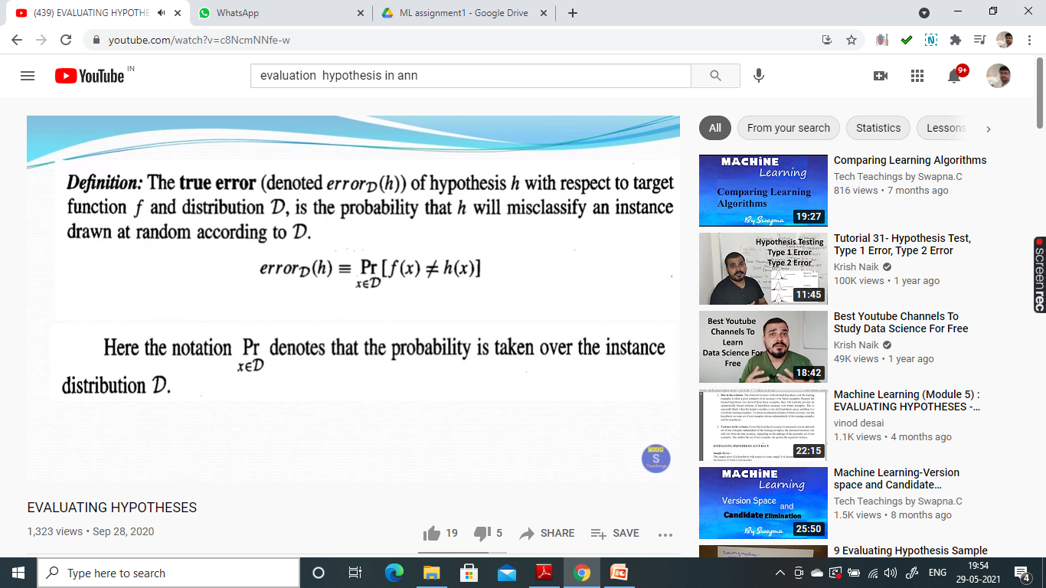

Slide 10
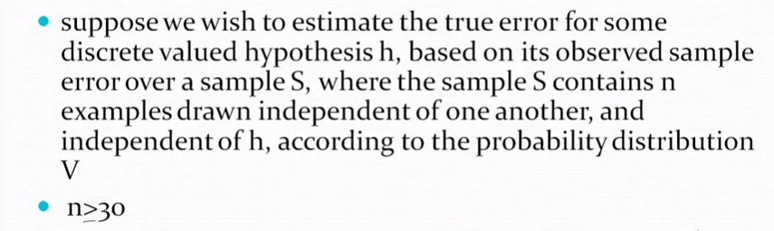
CONFIDENCE INTERVALS OF EVALUATING HYPOTHESIS
Hypothesis h commits r errors over these n examples (i.e., errors(h) = r/n)

Slide 11
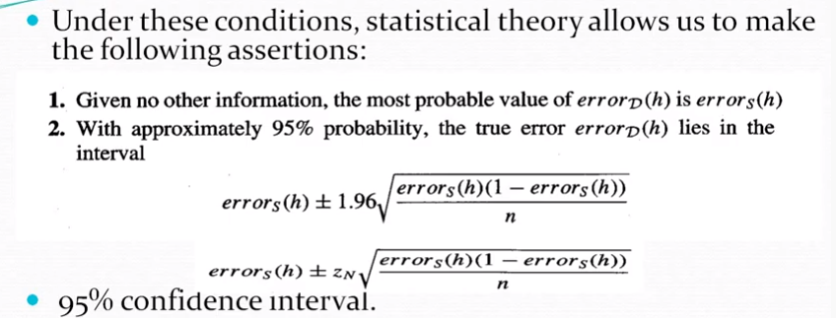
zN is different constant is used to calculate N% confidence interval

Slide 12
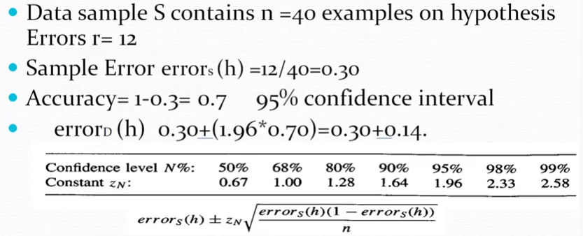
If it satisfies then that is the correct interval
n * errorss (h) * (1- errorss (h)) ≥ 5

Slide 13
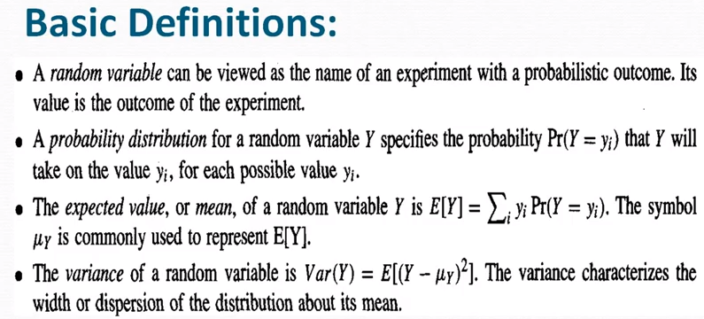
BASICS OF SAMPLING THEORY

Slide 14
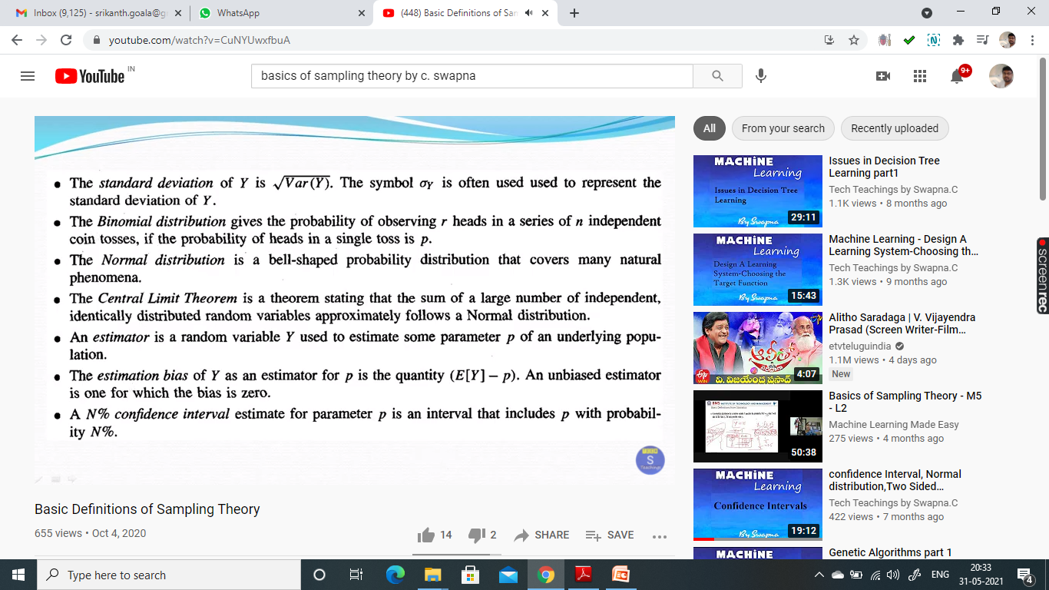

Slide 15
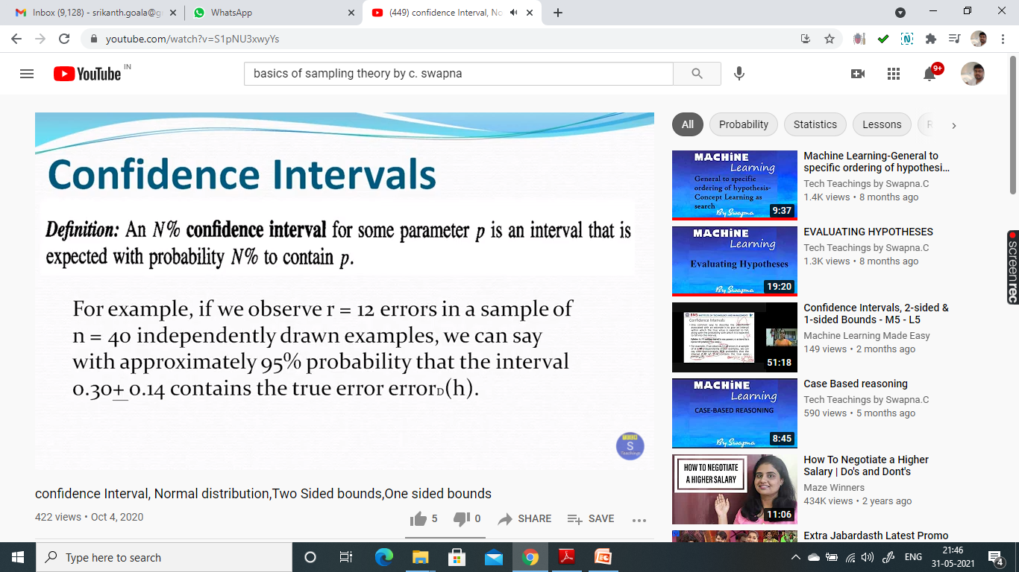

Slide 16
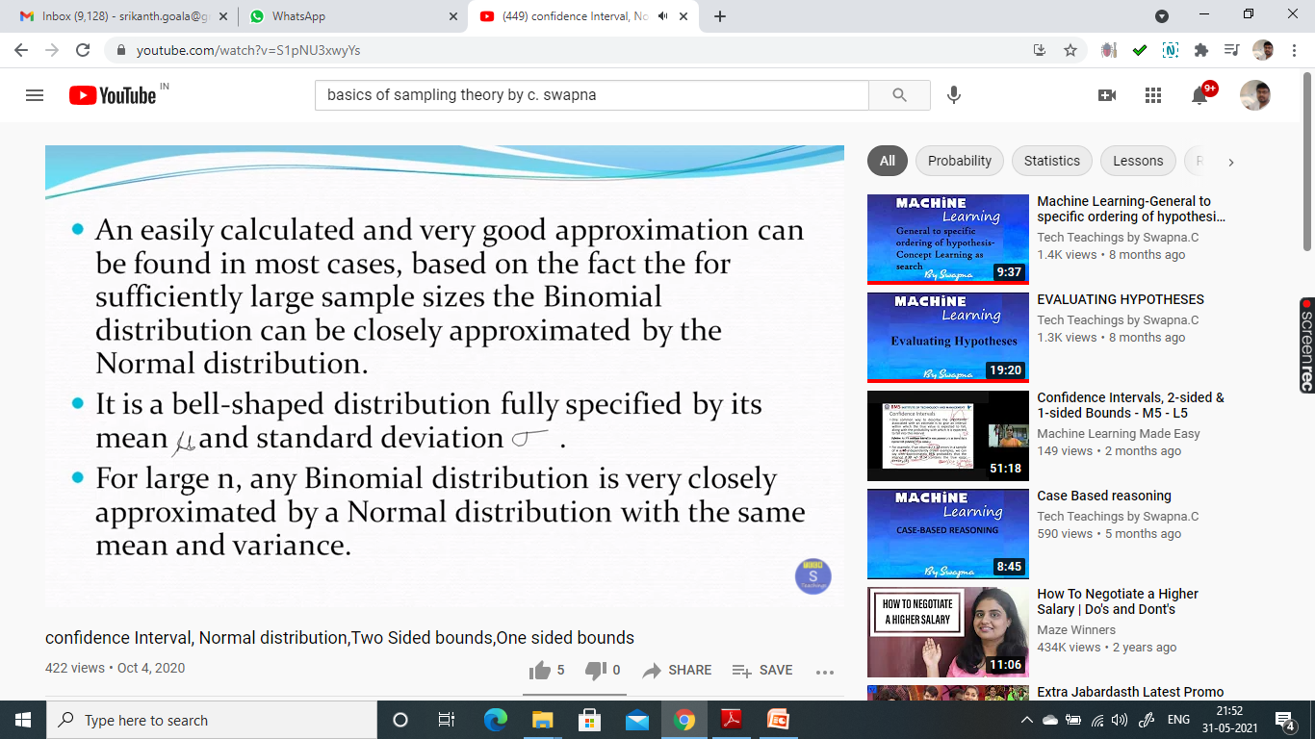

Slide 17
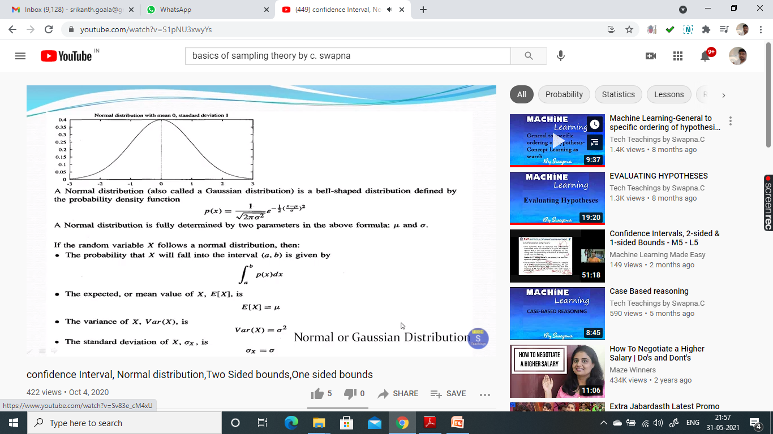

Slide 18
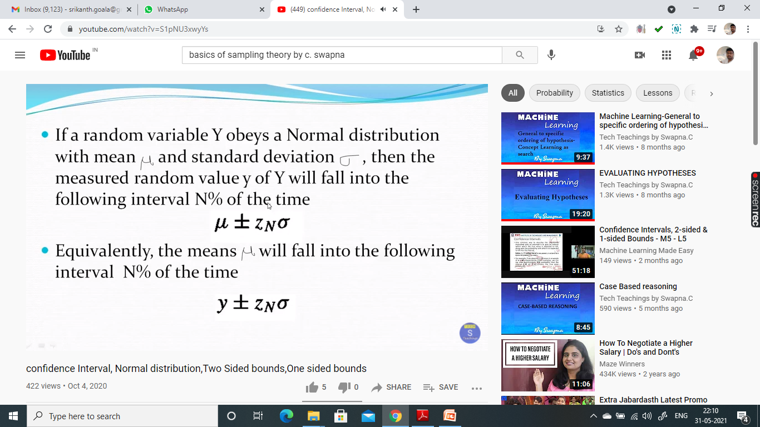

Slide 19
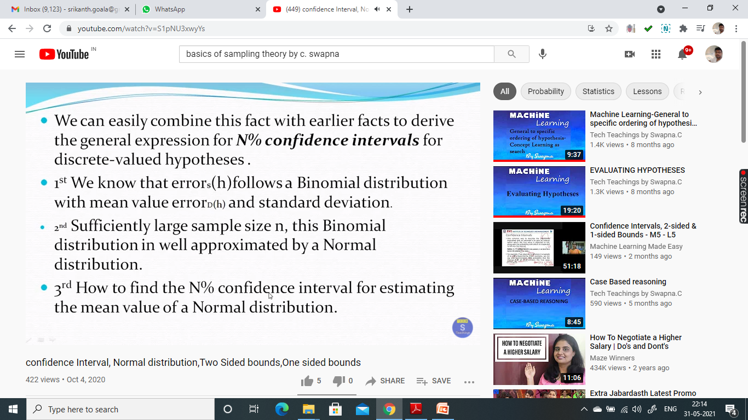

Slide 20
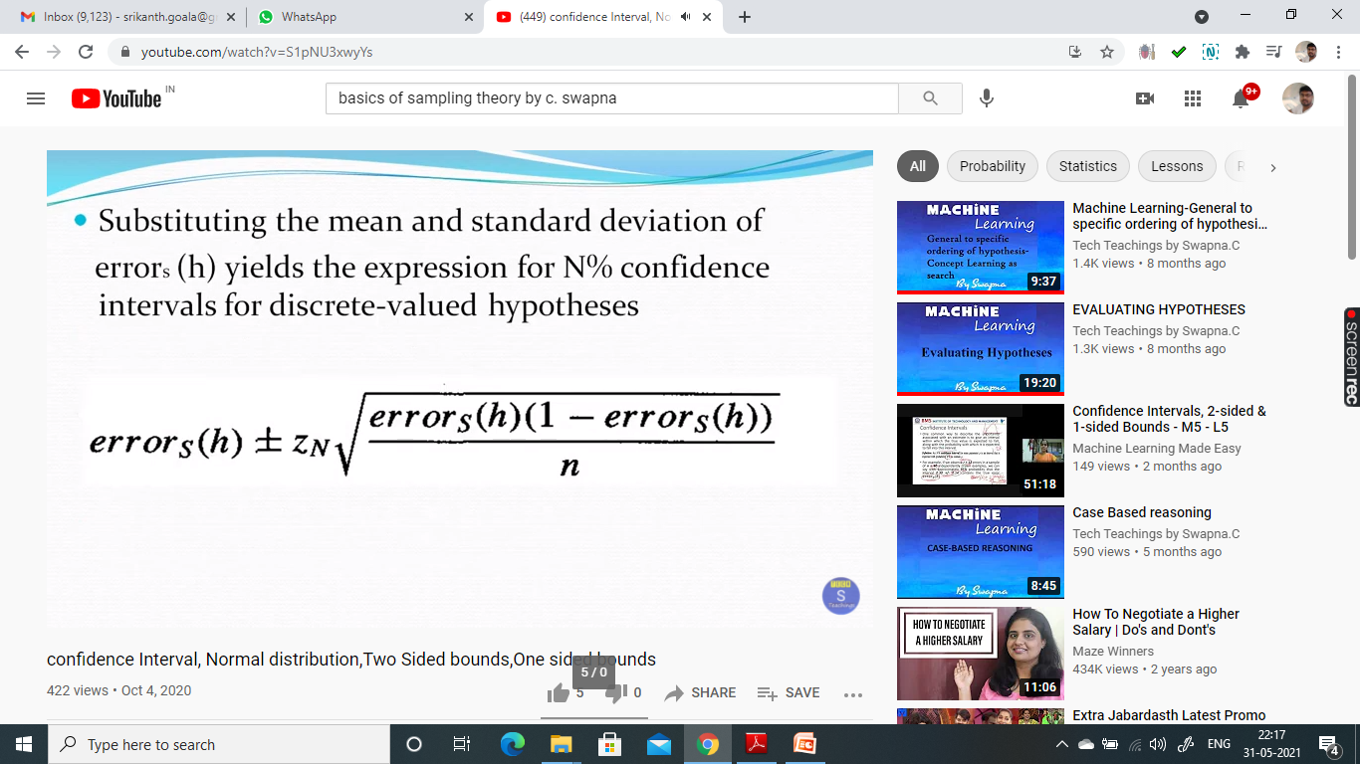

Slide 21
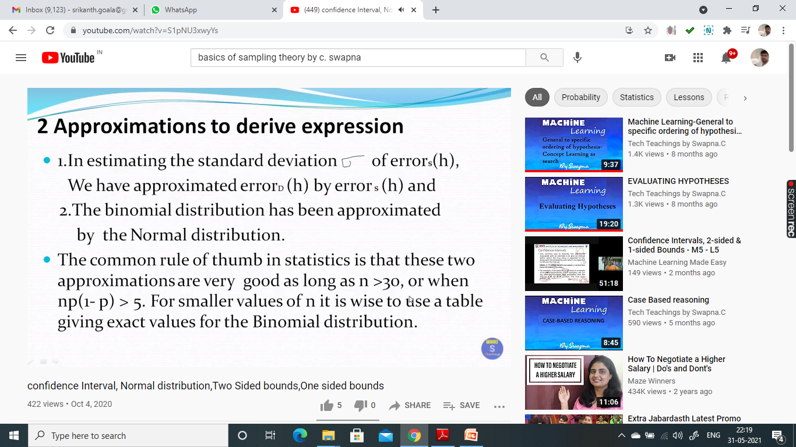

Slide 22


Slide 23
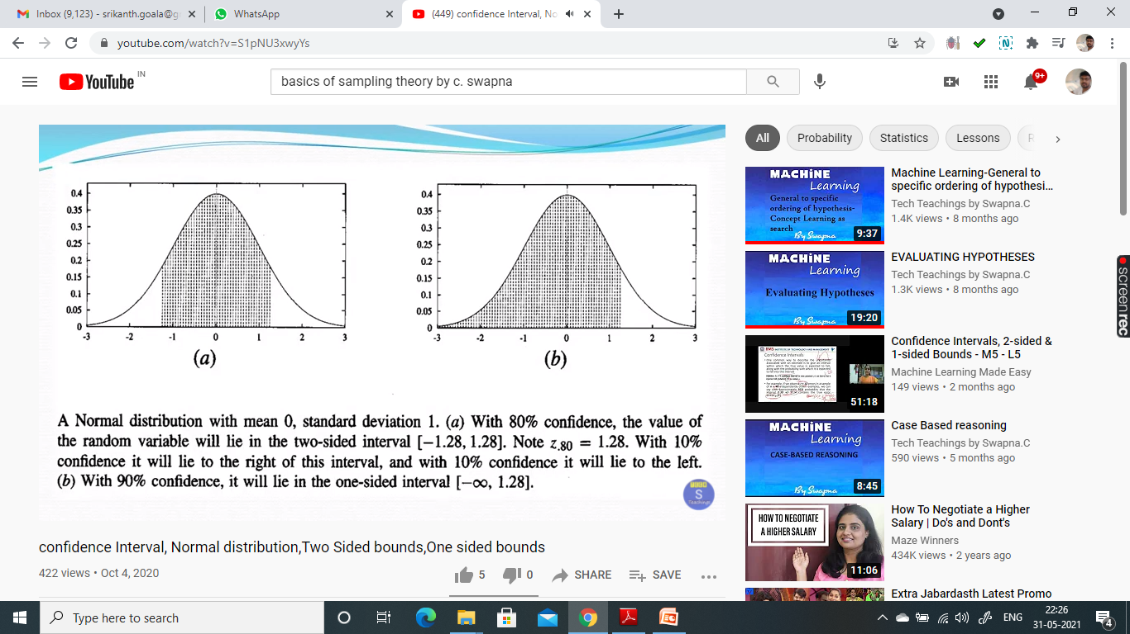

Slide 24


Slide 25
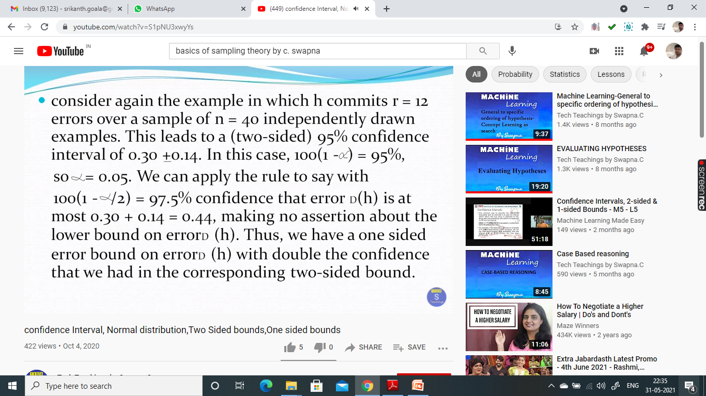

Slide 26
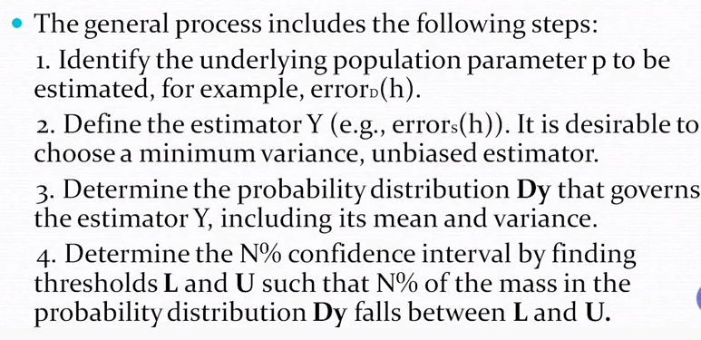
A GENERAL APPROACH FOR DERIVING CONFIDENCE INTERVALS

Slide 27
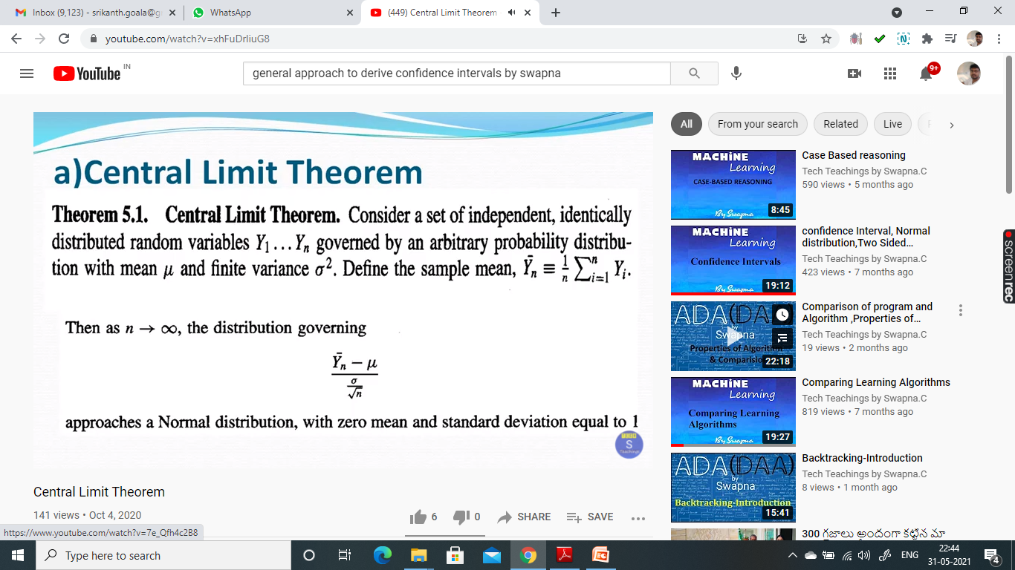

Slide 28
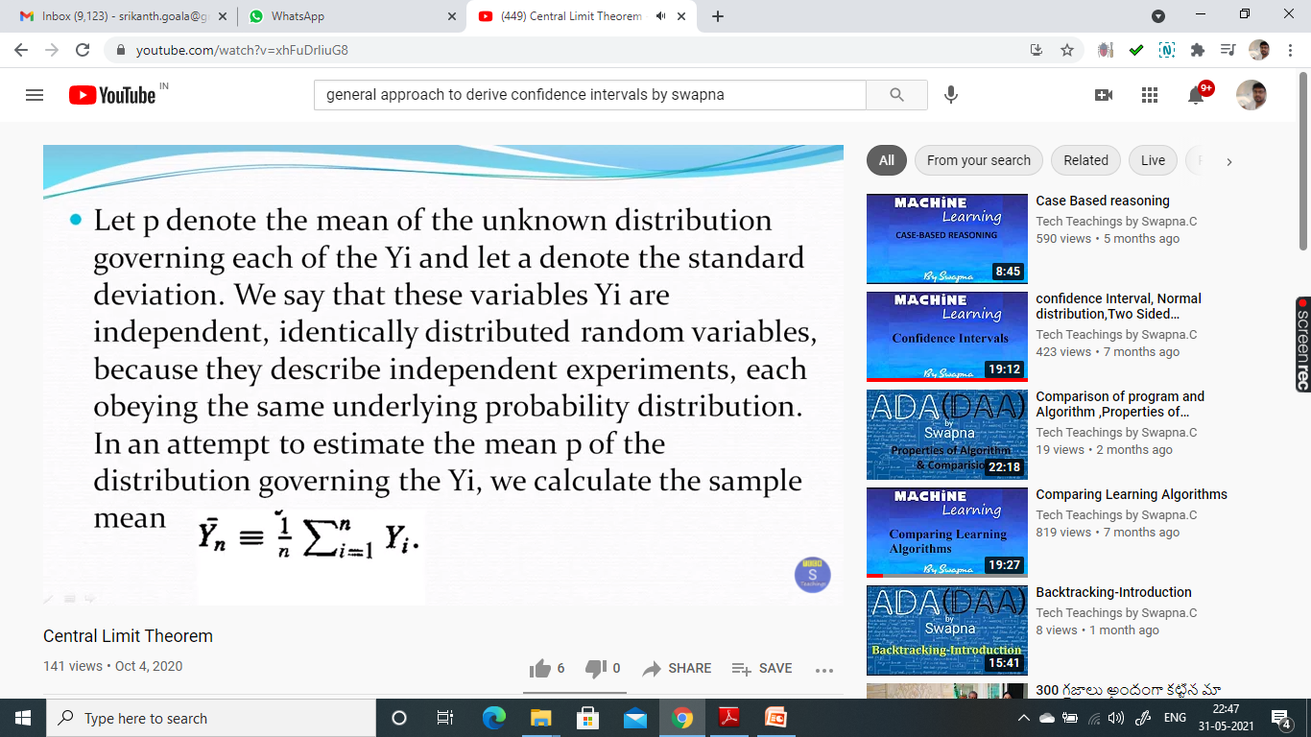

Slide 29
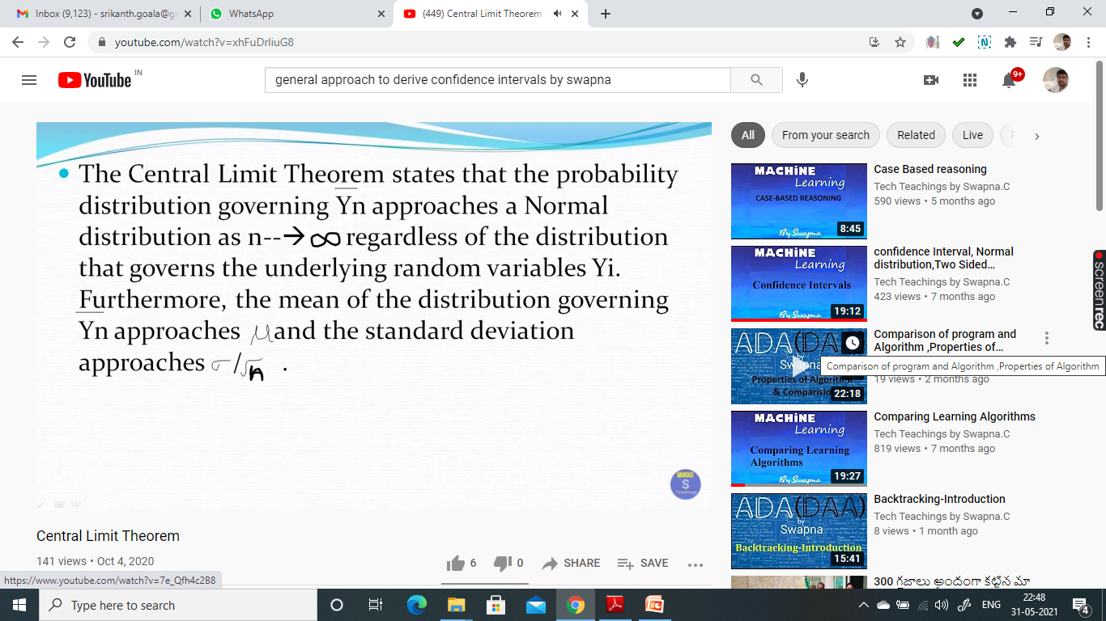

Slide 30


Slide 31
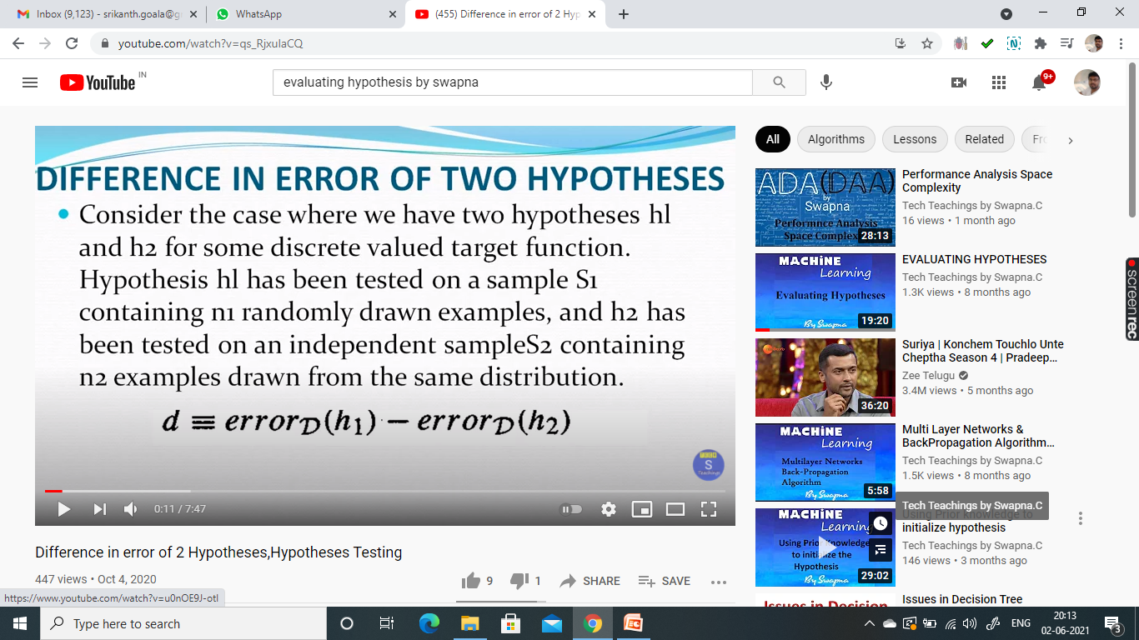
DIFFERENCE IN ERRORS OF TWO HYPOTHESIS

Slide 32
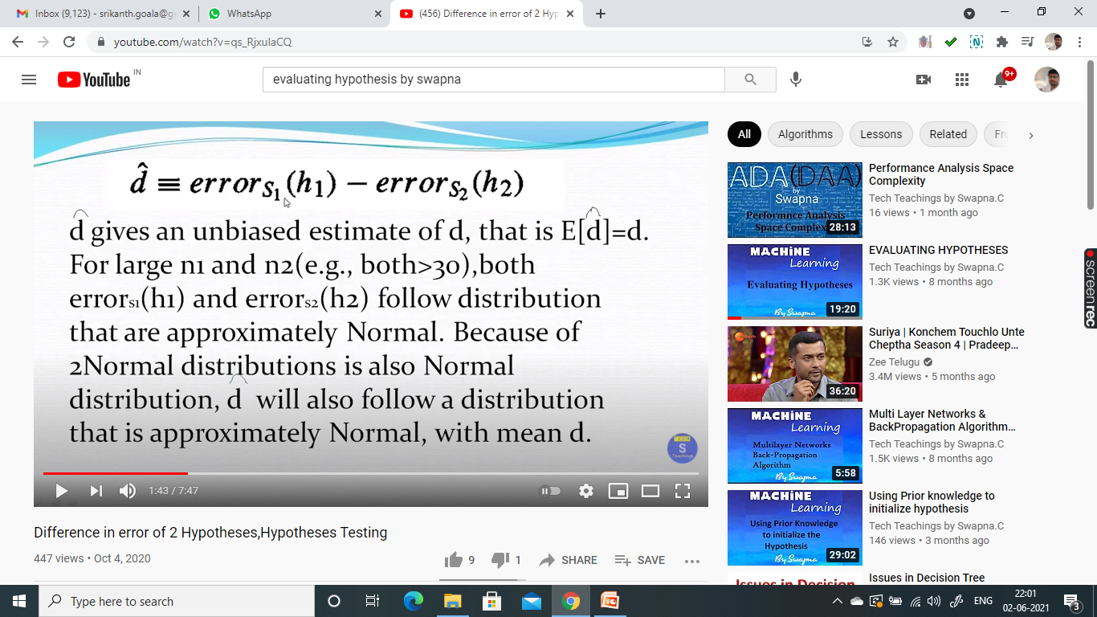

Slide 33
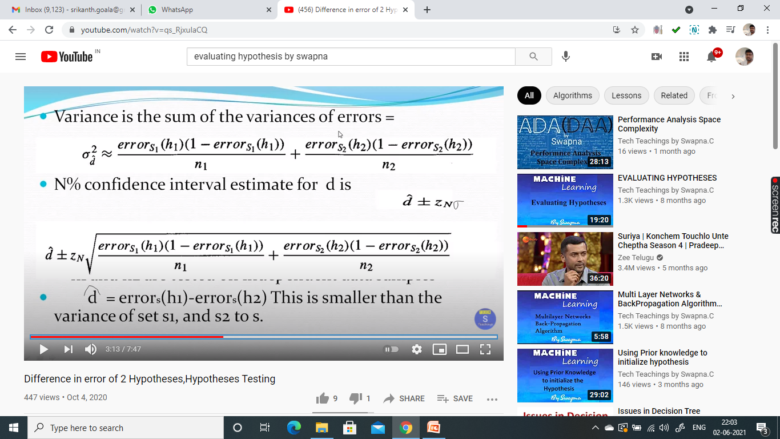

Slide 34
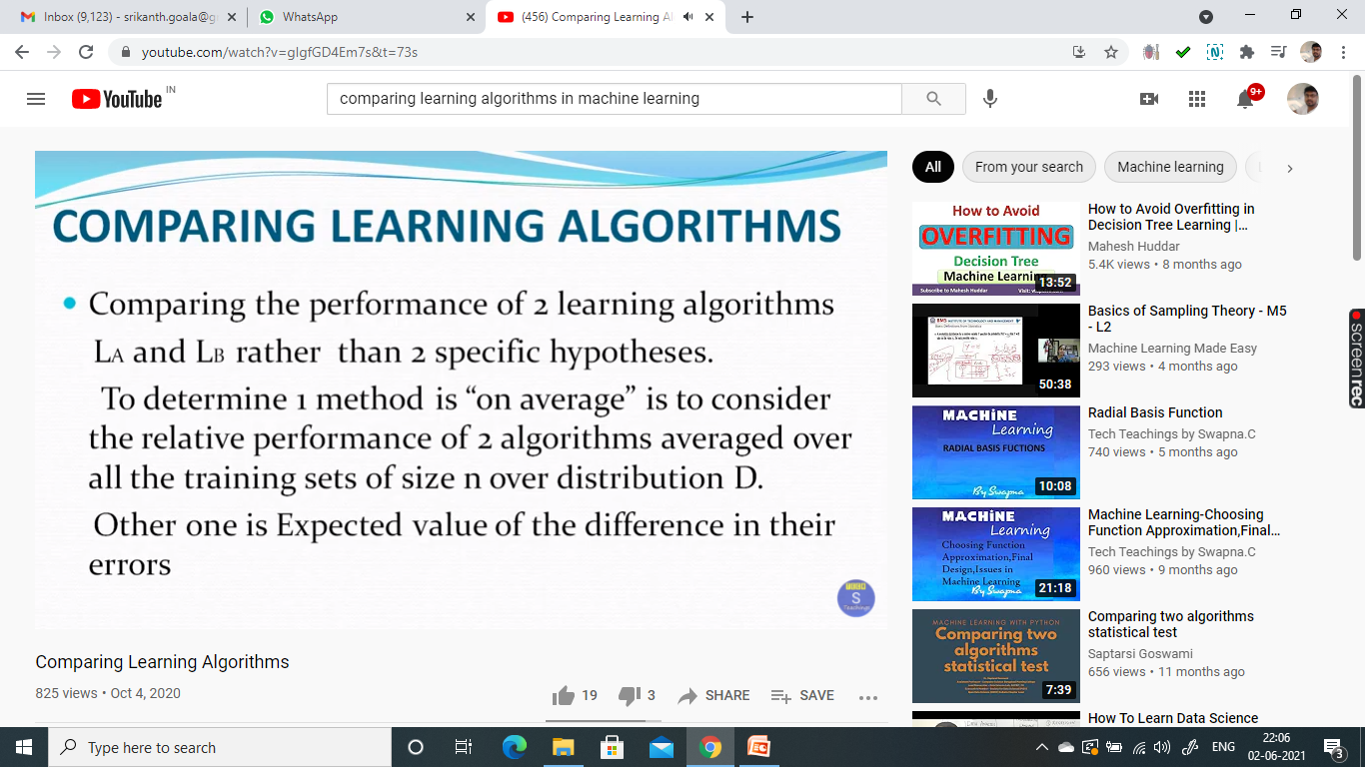

Slide 35
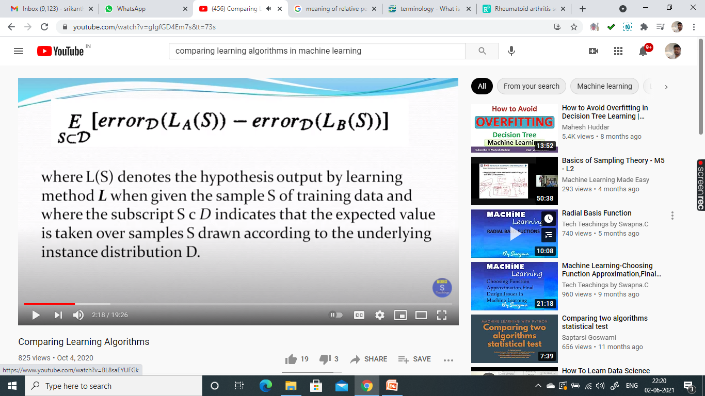

Slide 36
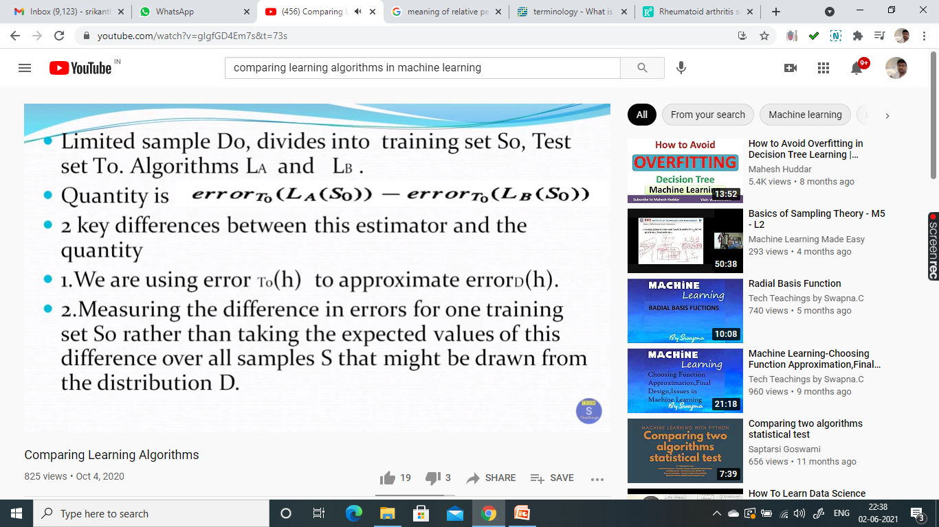

Slide 37
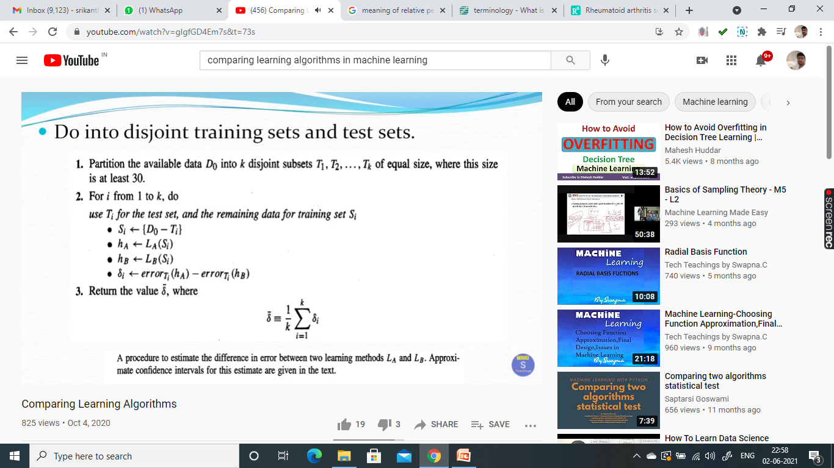

Slide 38
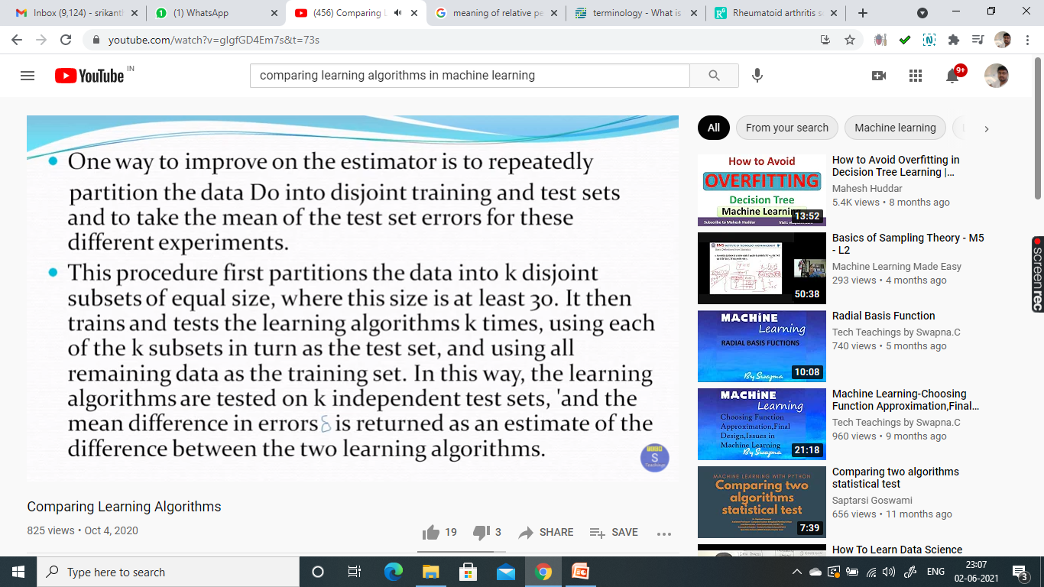

Slide 39
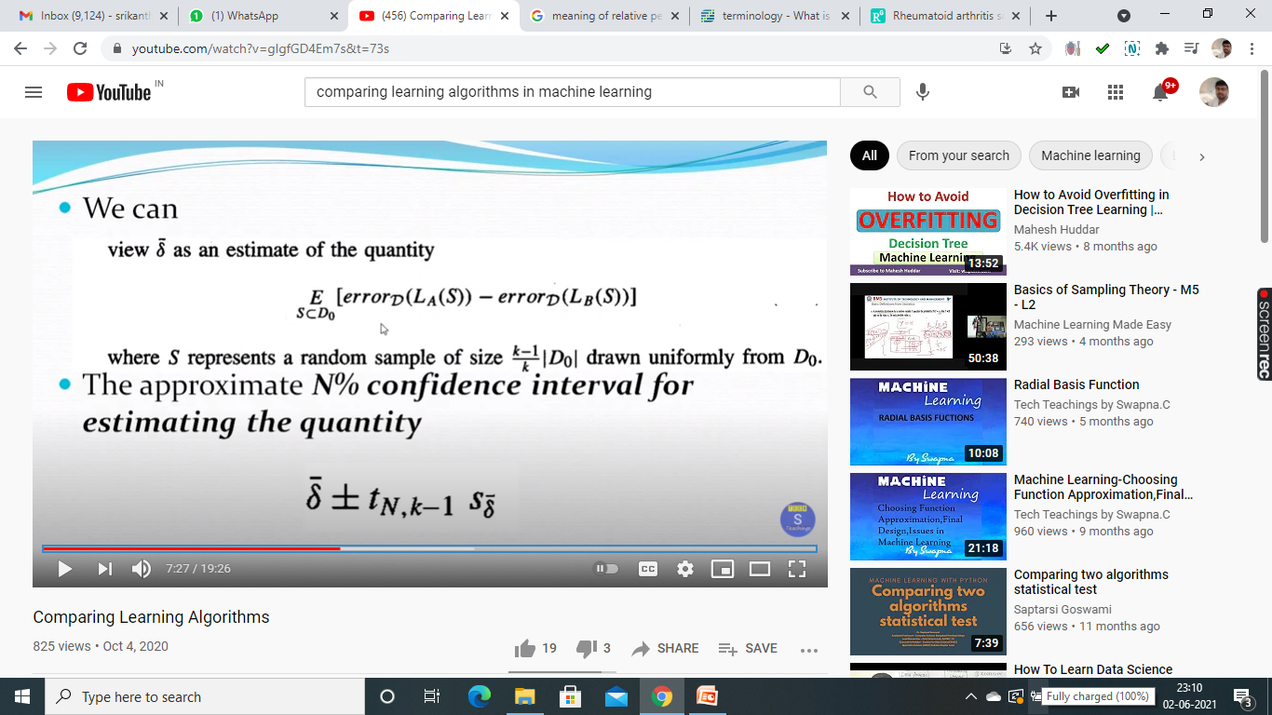

Slide 40
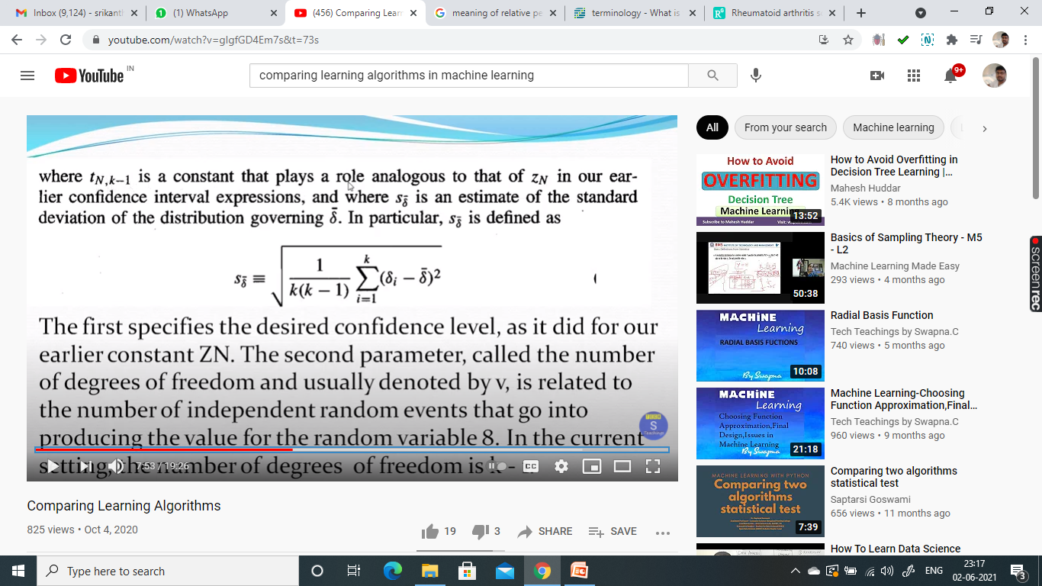
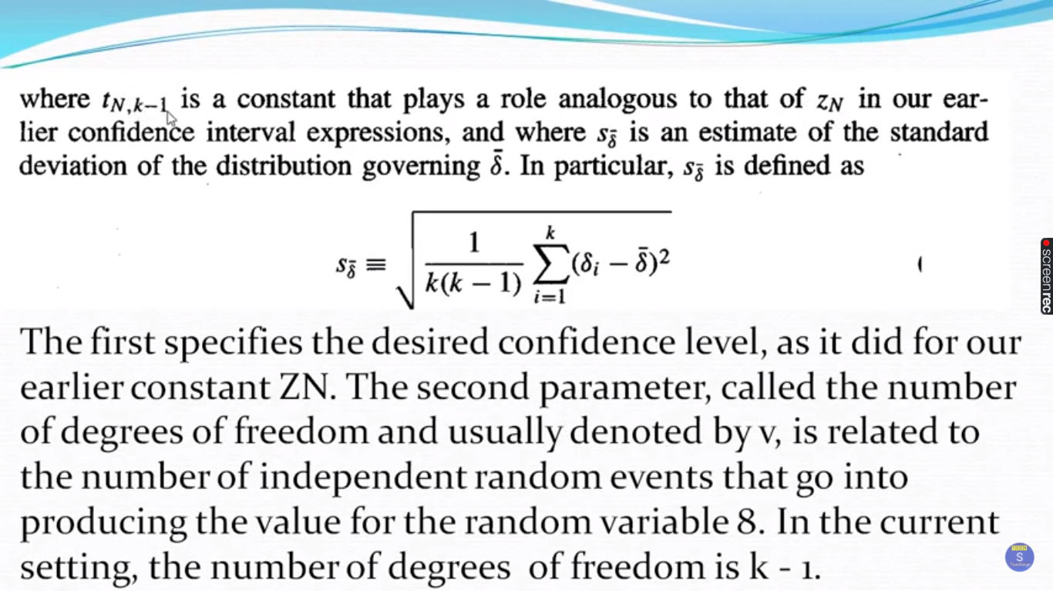

Slide 41
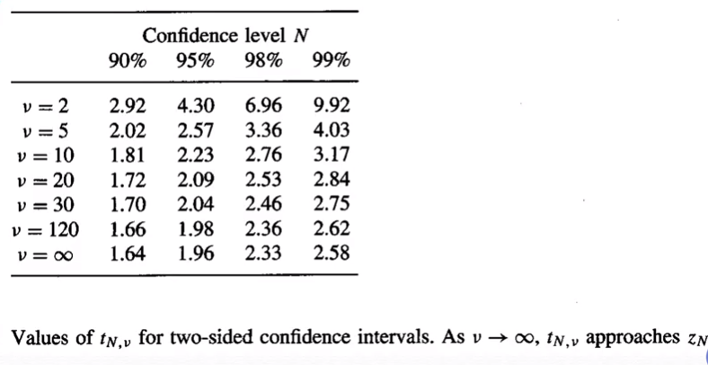

Slide 42
THANK YOU

